Slide 1
Core Spring 5.x
Rajeev Gupta MTech CS
Java Trainer & Consultant

Slide 2
Agenda
Introduction to Spring framework
Dependency Injection using xml
Constructor, setter injection
C and p namespace
Scopes
Autowire
Collection mappings
Bean factory vs application context
Splitting configuration in multiple files
Bean life cycle
Dependency Injection using annotation
@Autowired , @Qualifier, @Resource, @PostConstruct , @Predestroy, @Service, @Repository
Dependency Injection using java configuration
AnnotationConfigApplicationContext
@Configuration, @Bean, @Import, @Scope
@PropertySources
Using Environment to retrieve properties
Using Java configuration
What are Profiles?
Activating profiles
rgupta.mtech@gmail.com

Slide 3
Agenda
Introduction to Spring framework
Dependency Injection using xml
Constructor, setter injection
C and p namespace
Scopes
Autowire
Collection mappings
Bean factory vs application context
Splitting configuration in multiple files
Bean life cycle
Dependency Injection using annotation
@Autowired , @Qualifier, @Resource, @PostConstruct , @Predestroy, @Service, @Repository
Dependency Injection using java configuration
AnnotationConfigApplicationContext
@Configuration, @Bean, @Import, @Scope
@PropertySources
Using Environment to retrieve properties
Using Java configuration
What are Profiles?
Activating profiles
rgupta.mtech@gmail.com

Slide 4
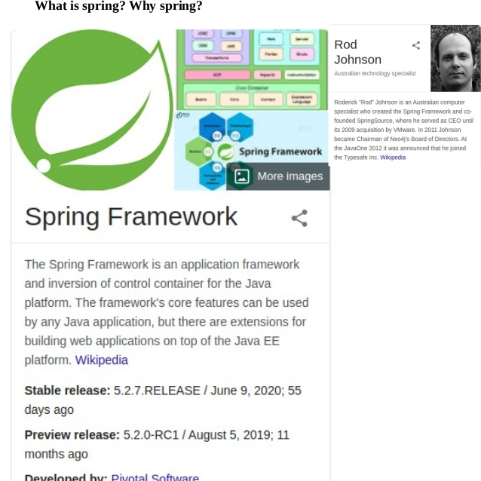

Slide 5
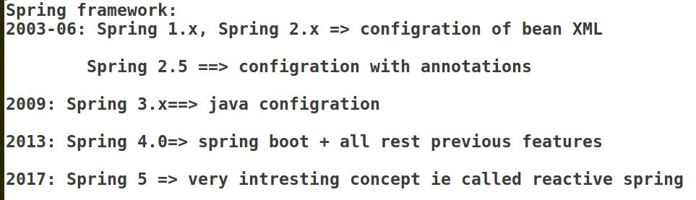

Slide 6
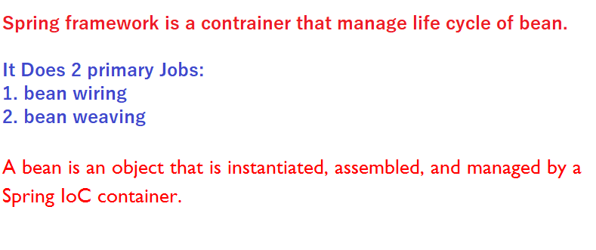

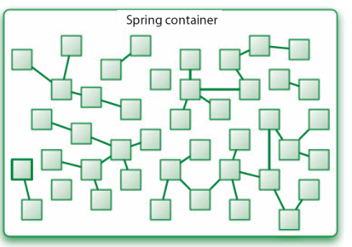
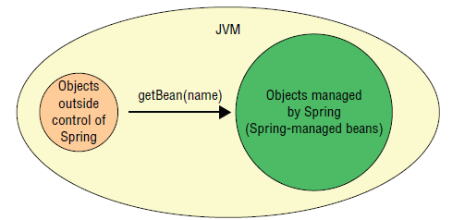
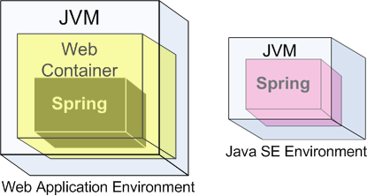

What is spring framework?
rgupta.mtech@gmail.com

Slide 7
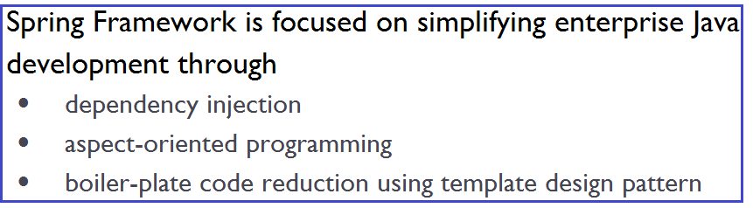
Why Spring framework?
Spring framework can be summarized in two ways:
Spring as and Container
Light weight container that do not need any installation, configurations start/stop activities.
Just collection of some jars
Spring an framework provides API
To integrate various technologies
rgupta.mtech@gmail.com

Slide 8
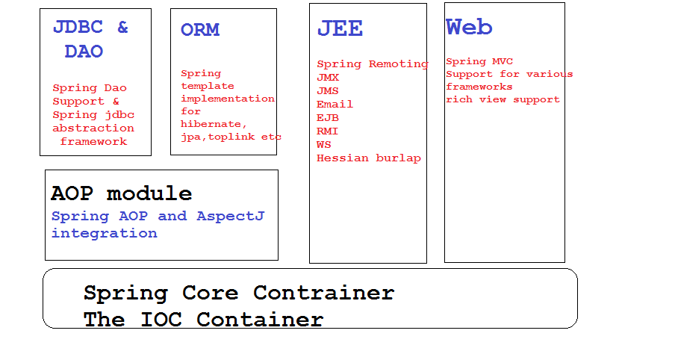
Some of Spring modules
rgupta.mtech@gmail.com

Slide 9
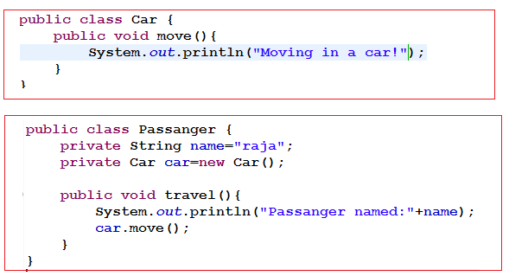
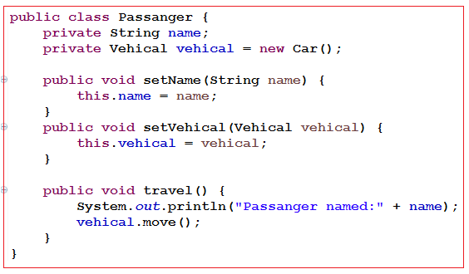
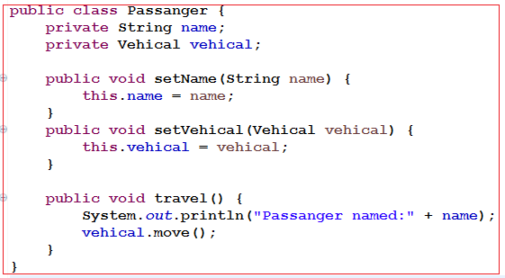
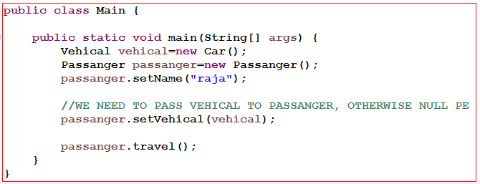
Need Of DI? An passenger need to travel
Attempt 1: Attempt 2:
Attempt 3: Supplying vehicle from outside world
rgupta.mtech@gmail.com

Slide 10
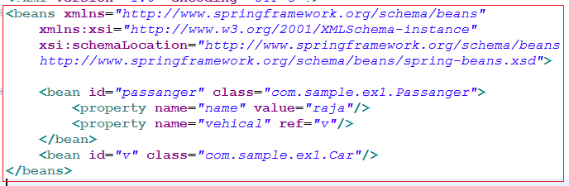

Need Of DI? An passenger need to travel
rgupta.mtech@gmail.com

Slide 11
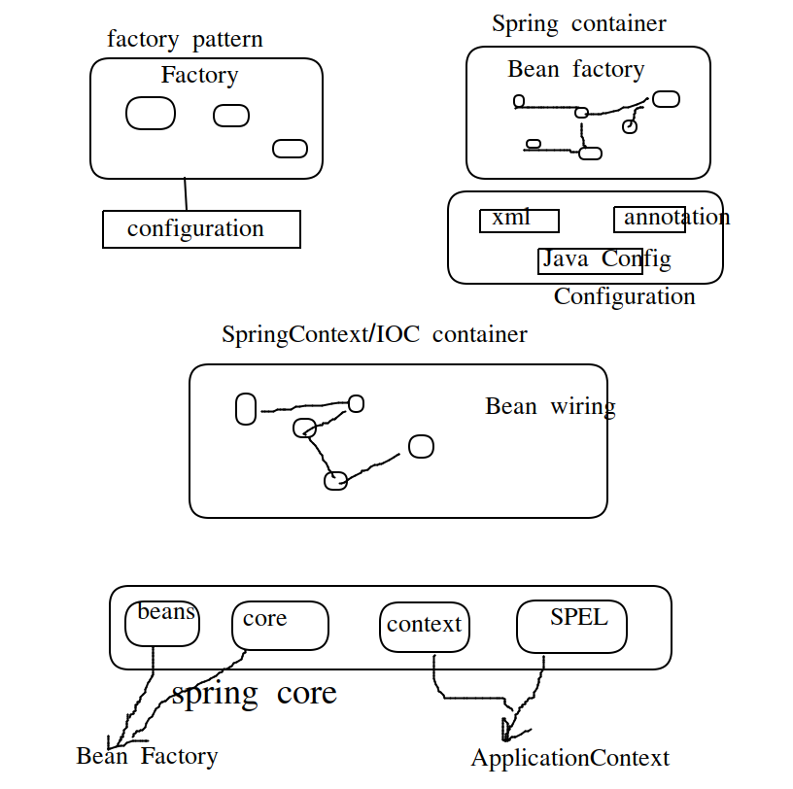

Slide 12
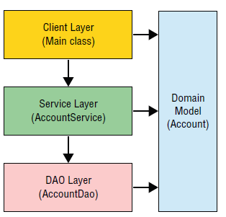


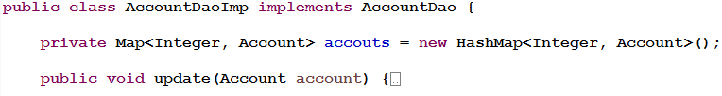

Bank Application
rgupta.mtech@gmail.com

Slide 13
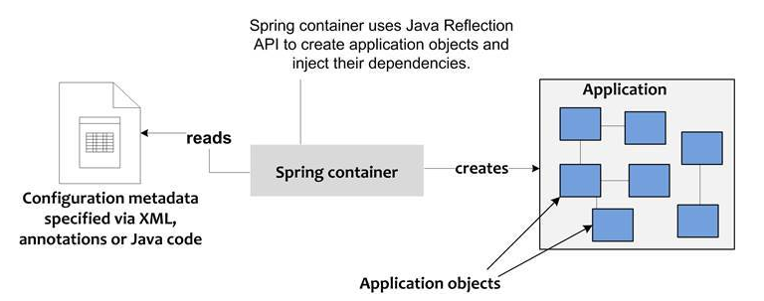

Slide 14
Agenda
Introduction to Spring framework
Dependency Injection using xml
Constructor, setter injection
C and p namespace
Scopes
Autowire
Collection mappings
Bean factory vs application context
Splitting configuration in multiple files
Bean life cycle
Dependency Injection using annotation
@Autowired , @Qualifier, @Resource, @PostConstruct , @Predestroy, @Service, @Repository
Dependency Injection using java configuration
AnnotationConfigApplicationContext
@Configuration, @Bean, @Import, @Scope
@PropertySources
Using Environment to retrieve properties
Using Java configuration
What are Profiles?
Activating profiles
rgupta.mtech@gmail.com

Slide 15


Dependency Injection Using XML
Setter Injection
Constructor Injection
c namespace
p namespace
rgupta.mtech@gmail.com

Slide 16
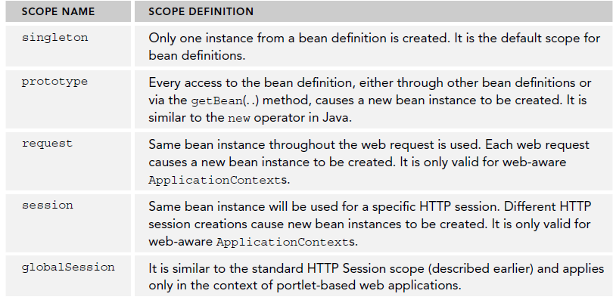
Bean Scopes
rgupta.mtech@gmail.com

Slide 17
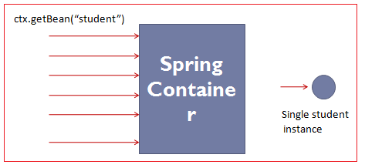
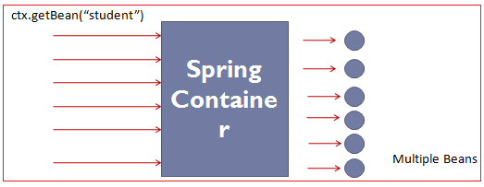
Singleton vs Prototype
rgupta.mtech@gmail.com

Slide 18
Autowiring
AKA shortcut.
Default mode: Auto-Wiring "no"
Type of auto wiring: byName, byType
rgupta.mtech@gmail.com

Slide 19
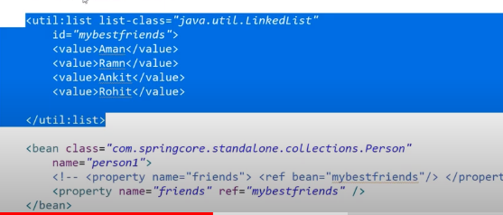
Collection Mapping
Collection mapping supported by Spring :
List:<list> - </list>
Set:<set> - </set>
Map:<map> - </map>
Properties:<props> - </props>
rgupta.mtech@gmail.com

Slide 20

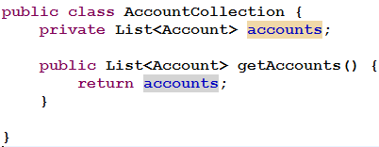
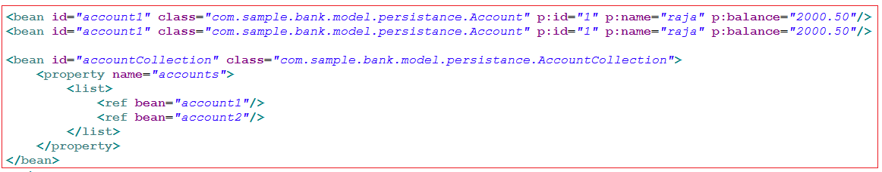
List Collection Mapping
rgupta.mtech@gmail.com

Slide 21
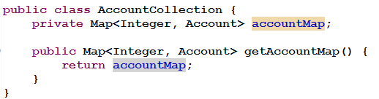
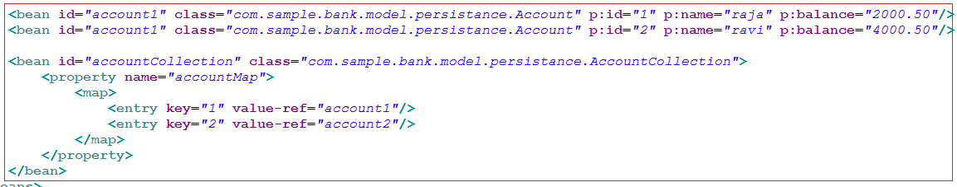
Map Collection mapping
rgupta.mtech@gmail.com

Slide 22
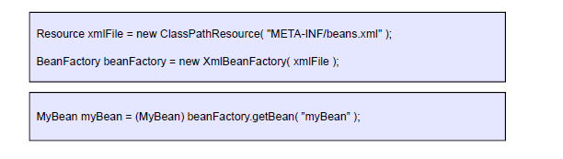
BeanFactory
Provides basic support for dependency injection
Lightweight
XMLBeanFactory most commonly used implementation
rgupta.mtech@gmail.com

Slide 23
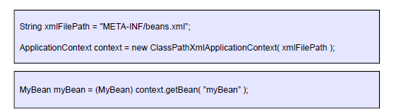
ApplicationContext
Built on top of the BeanFactory
Provides more enterprise-centric functionality
Internationalization of messages
AOP, transaction management
Preferred over the BeanFactory in most situations
Most commonly used implementation is the ClassPathXmlApplicationContext
ApplicationContext context = new FileSystemXmlApplicationContext("c:/foo.xml");
ApplicationContext context = new ClassPathXmlApplicationContext("foo.xml");
rgupta.mtech@gmail.com

Slide 24
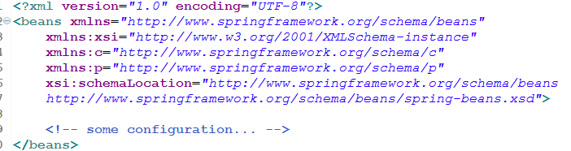

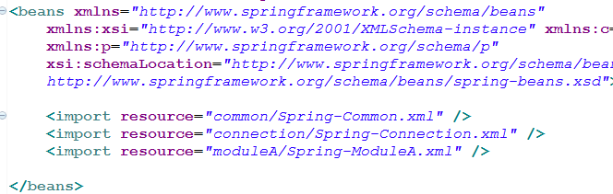
Splitting configuration in multiple file
bean1.xml bean2.xml
Better solution:-
rgupta.mtech@gmail.com

Slide 25
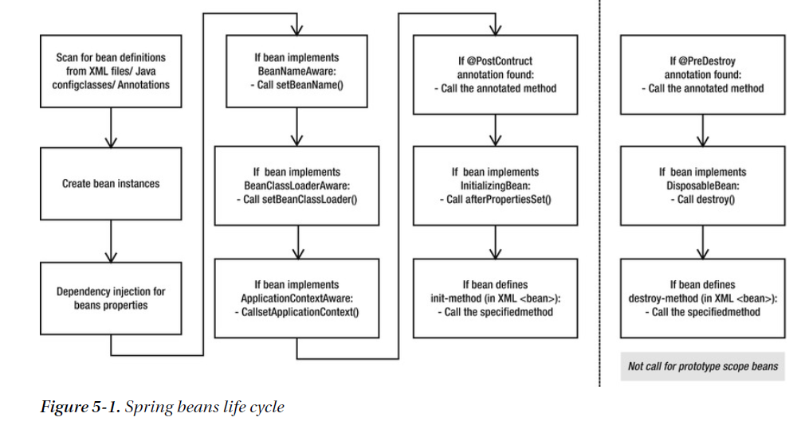
Spring bean life cycle
rgupta.mtech@gmail.com

Slide 26
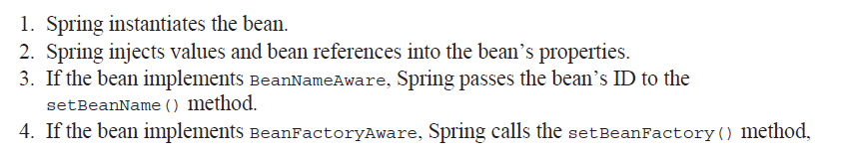
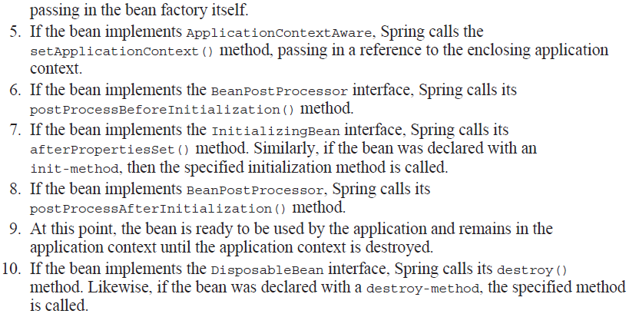
Beans Life cycle
rgupta.mtech@gmail.com

Slide 27
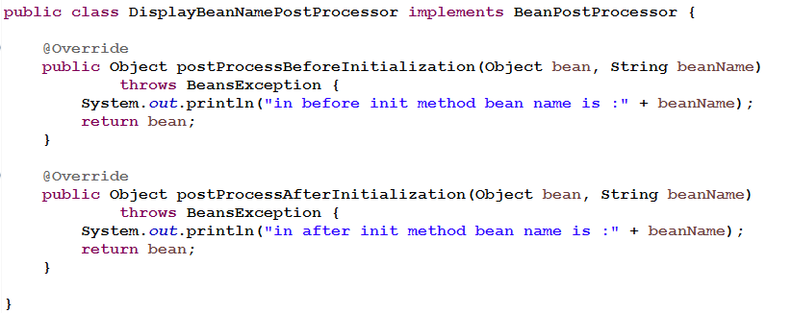
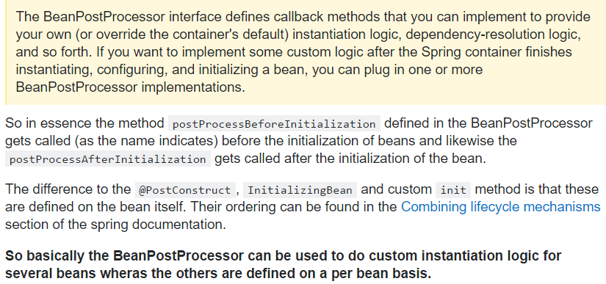
BeanPostProcessor
rgupta.mtech@gmail.com

Slide 28
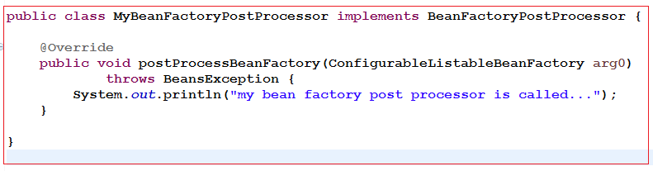
BeanFactoryPostProcessor
BeanFactoryPostProcessor is invoked before bean factory is initilized (and before any bean is initialized)
There are many BeanFactoryPostProcessor available by default in spring framework such as PropertyPlaceholderConfigurer
PropertyPlaceholderConfigurer is used to read values form properties files before initilization of beanfactory
Configuration
rgupta.mtech@gmail.com

Slide 29
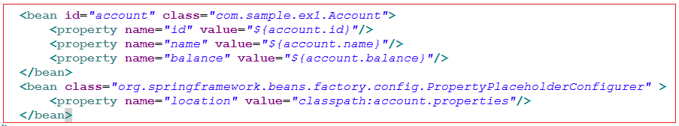


PropertyPlaceHolderConfigurer
rgupta.mtech@gmail.com

Slide 30
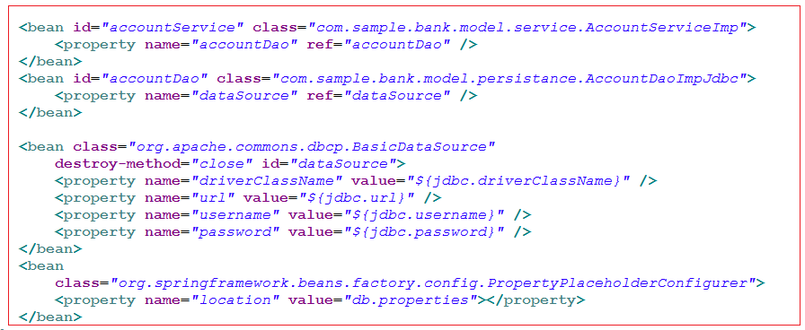
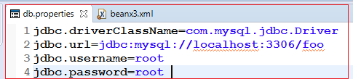
PropertyPlaceHolderConfigurer:DB Configureation
rgupta.mtech@gmail.com

Slide 31
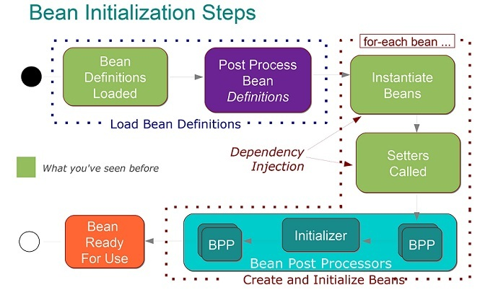

Slide 32
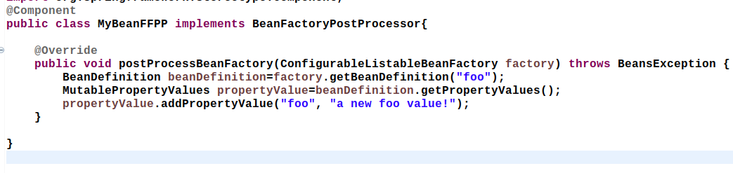

Slide 33
Agenda
Introduction to Spring framework
Dependency Injection using xml
Constructor, setter injection
C and p namespace
Scopes
Autowire
Collection mappings
Bean factory vs application context
Splitting configuration in multiple files
Bean life cycle
Dependency Injection using annotation
@Autowired , @Qualifier, @Resource, @PostConstruct , @Predestroy, @Service, @Repository
Dependency Injection using java configuration
AnnotationConfigApplicationContext
@Configuration, @Bean, @Import, @Scope
@PropertySources
Using Environment to retrieve properties
Using Java configuration
What are Profiles?
Activating profiles
rgupta.mtech@gmail.com

Slide 34
Dependency Injection using annotations
@Value - to inject a simple property
@Autowire -to inject a property automatically
@Component:@Controller @Service and @Repository
@Qualifier - while autowiring, fix the name to an particular bean
@Required - mandatory to inject, apply on setter
@PostConstructs- Life cycle post
@PreDestroy- Life cycle pre
JSR 250 Annotations:
@Resource, @PostConstruct/ @PreDestroy, @Component
JSR 330 Annotations:
@Named annotation in place of @Resouce
@Inject annotation in place of @Autowire
rgupta.mtech@gmail.com

Slide 35
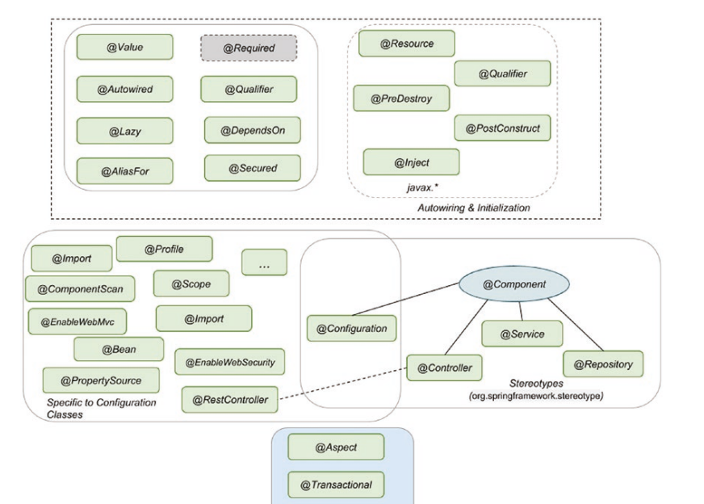

Slide 36
Agenda
Introduction to Spring framework
Dependency Injection using xml
Constructor, setter injection
C and p namespace
Scopes
Autowire
Collection mappings
Bean factory vs application context
Splitting configuration in multiple files
Bean life cycle
Dependency Injection using annotation
@Autowired , @Qualifier, @Resource, @PostConstruct , @Predestroy, @Service, @Repository
Dependency Injection using java configuration
AnnotationConfigApplicationContext
@Configuration, @Bean, @Import, @Scope
@PropertySources
Using Environment to retrieve properties
Using Java configuration
What are Profiles?
Activating profiles
rgupta.mtech@gmail.com

Slide 37
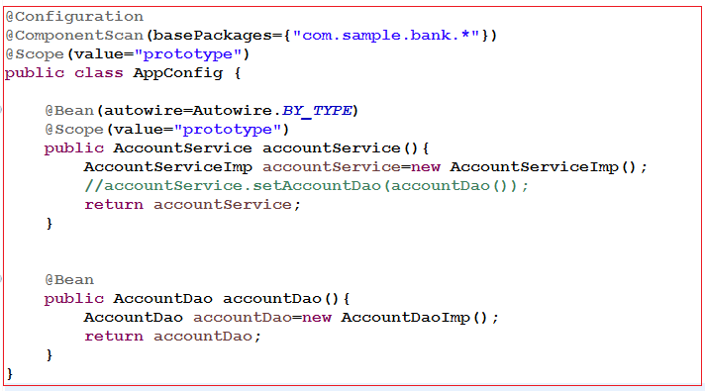
DI using Java Configuration
rgupta.mtech@gmail.com

Slide 38
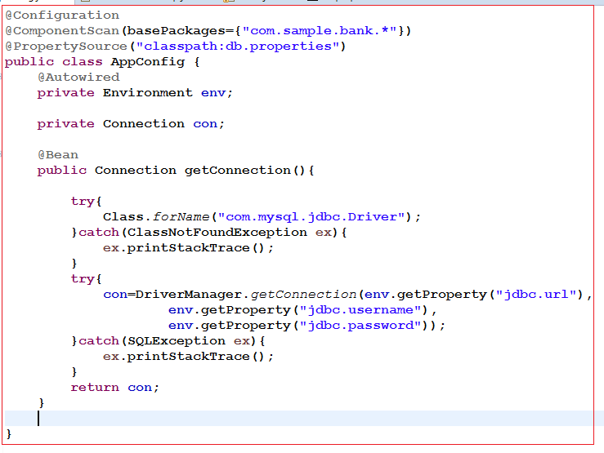

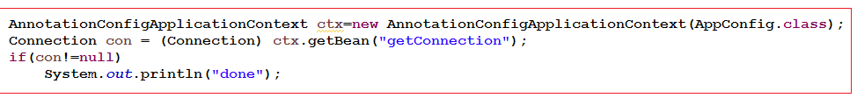
@PropertySource & Using Environment to retrieve properties
rgupta.mtech@gmail.com

Slide 39
Agenda
Introduction to Spring framework
Dependency Injection using xml
Constructor, setter injection
C and p namespace
Scopes
Autowire
Collection mappings
Bean factory vs application context
Splitting configuration in multiple files
Bean life cycle
Dependency Injection using annotation
@Autowired , @Qualifier, @Resource, @PostConstruct , @Predestroy, @Service, @Repository
Dependency Injection using java configuration
AnnotationConfigApplicationContext
@Configuration, @Bean, @Import, @Scope
@PropertySources
Using Environment to retrieve properties
Using Java configuration
What are Profiles?
Activating profiles
rgupta.mtech@gmail.com

Slide 40
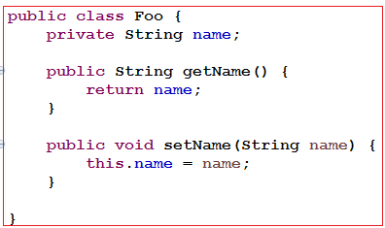
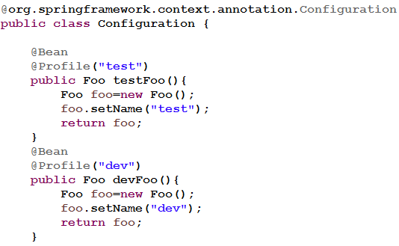
Profile Using Java configuration
What are Profiles?
@Profile allow developers to register beans by condition
We require to use caching in our book application we want to support two profile "dev" and "production"
If profile “dev” is enabled, return a simple cache manager ConcurrentMapCacheManager
If profile "production" is enabled, return an advanced cache manager – EhCacheCacheManager
rgupta.mtech@gmail.com

